Slide 1

Enhancing Aerial Surveillance: Wildfire Monitoring System with FPGA-Embedded Camera Drones Leveraging Detection-Transformer Model
Presented by
Anurag Deshmane (2001CS08) under the guidance of Rajiv Misra
Department of Computer Science and Engineering Indian Institute of Technology Patna

Slide 2

Contents
Issue Analysis, Objectives, and Aims
Proposed Novel Approach
Data Collection and Preprocessing
Model Training
Creation of a Lightweight Model
Evaluation through Quantitative and Qualitative Analysis
Implementation of the FPGA-Embedded Monitoring Drone

Slide 3
Research Objectives
Manual detection is unfeasible across expansive forestry areas for wildfire identification.
Precise Response of a Natural Disaster using Aerial/Drone Imagery.
To address the challenge of false positive alarms associated with traditional techniques.
To leverage the low latency of an Edge device and enabling fast communication for efficient response during natural disasters.
Cost Savings Through Early Detection of Wildfires to Reduce Damage.
Highly Scalable approach.

Slide 4
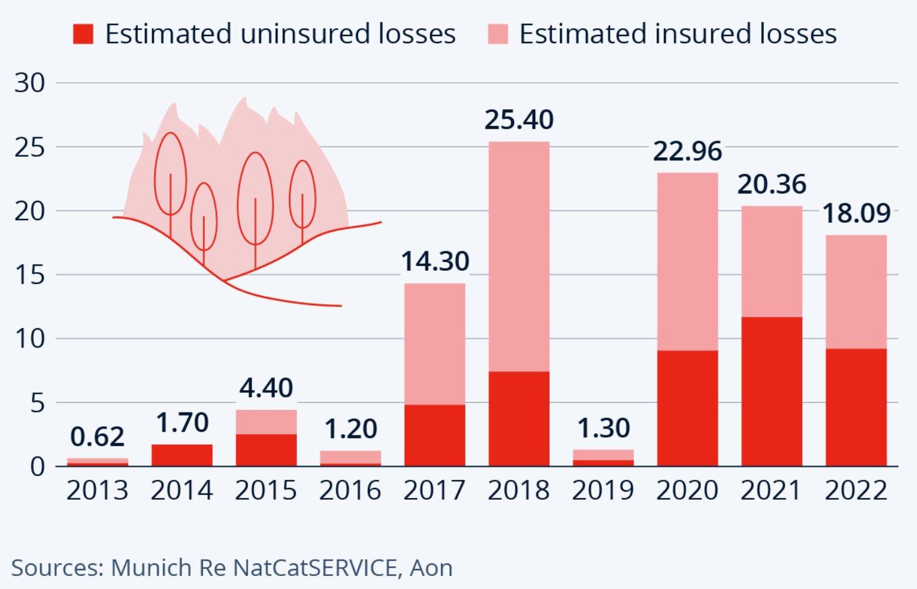
Introduction
Wildfires cause significant economic losses and environmental damage, requiring precise response measures.
Our machine learning solution utilize a Transformer architecture, achieving remarkable accuracy of in wildfire detection and response.
Employing Knowledge Distillation techniques, we've crafted a lightweight model designed for FPGA deployment.
Estimated losses caused by wildfires and heat in US (in Billion US Dollar)

Slide 5
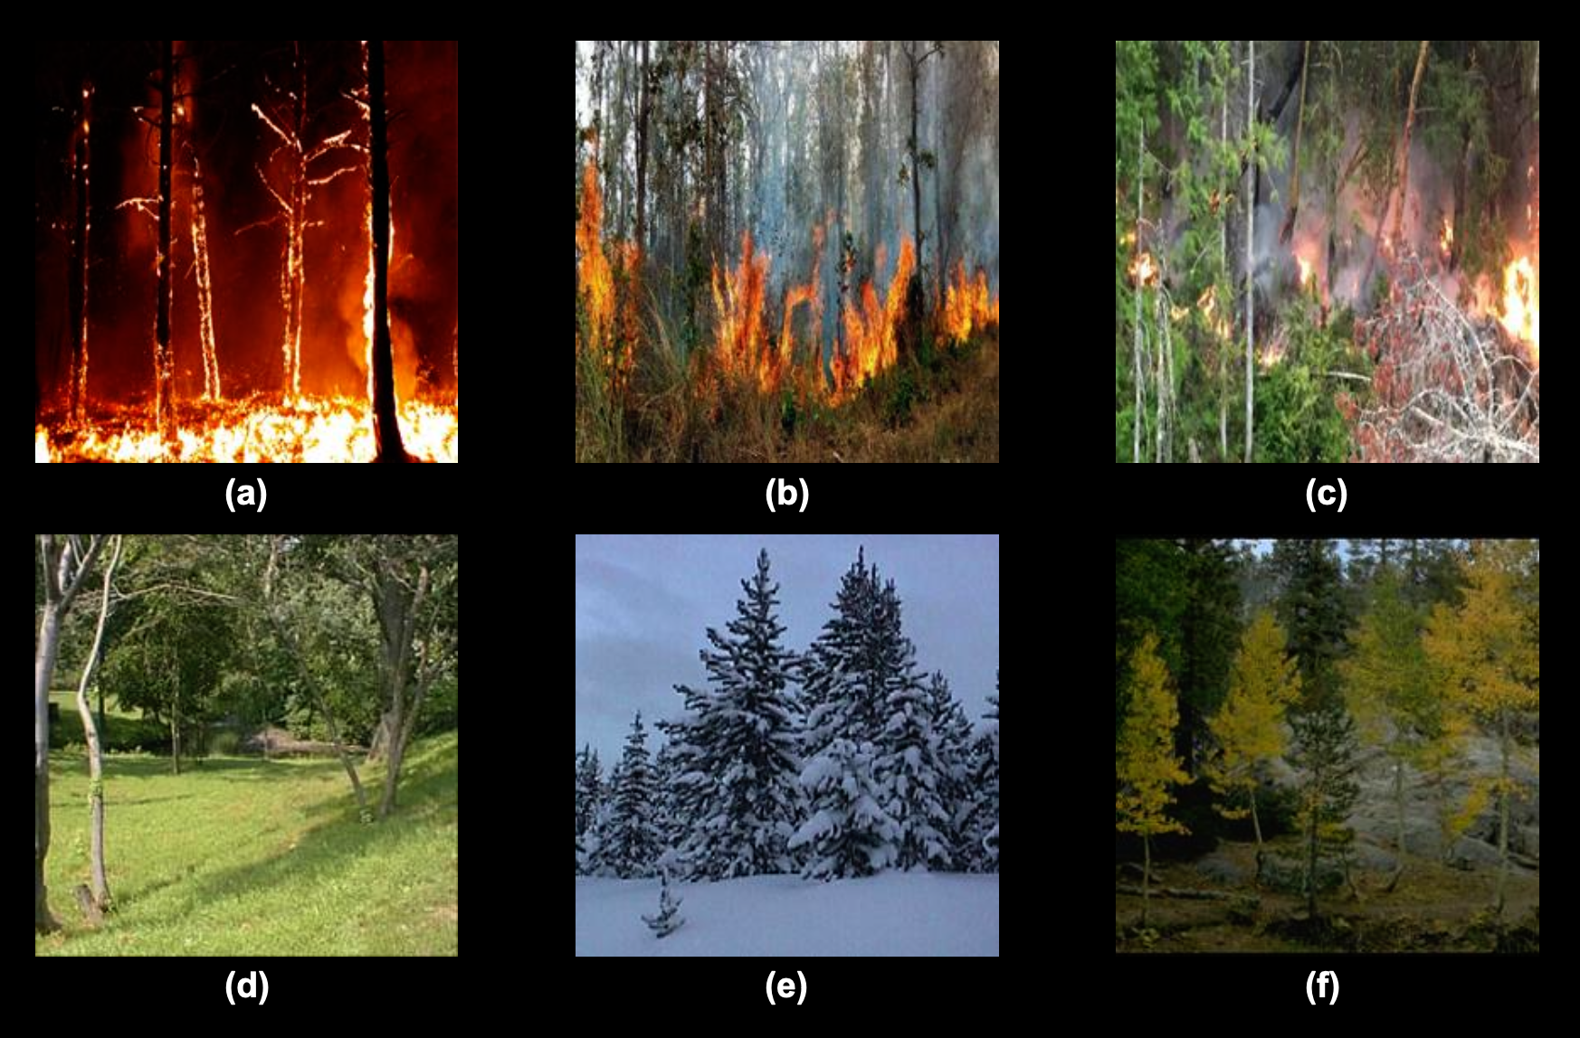
Data Collection and Preprocessing
To handle different kinds of forest fires(ground, trunk, canopy,etc) images has been collected from multiple public fire datasets:
Fire Detection Dataset from Roboflow Universe
Dataset for Forest Fire Detection in Mendeley Data
We utilized the COCO format for storing and sharing annotations for our image dataset.
A total of 8,309 images
3,506 Images depict Forest Fire (Image (a), (b) and (c))
4,803 Non-Fire Scenarios (Image (d), (e) and (f))

Slide 6
Data Collection and Preprocessing
Data Augmentation:
Flipping
Random Crop
Median Blur
The ImageNet mean values (0.485, 0.456, 0.406) and standard deviation values (0.229, 0.224, 0.225) are used to normalize pixel values across all RGB channels in images
Training : 60%
Validation : 20%
Testing : 20%

Slide 7
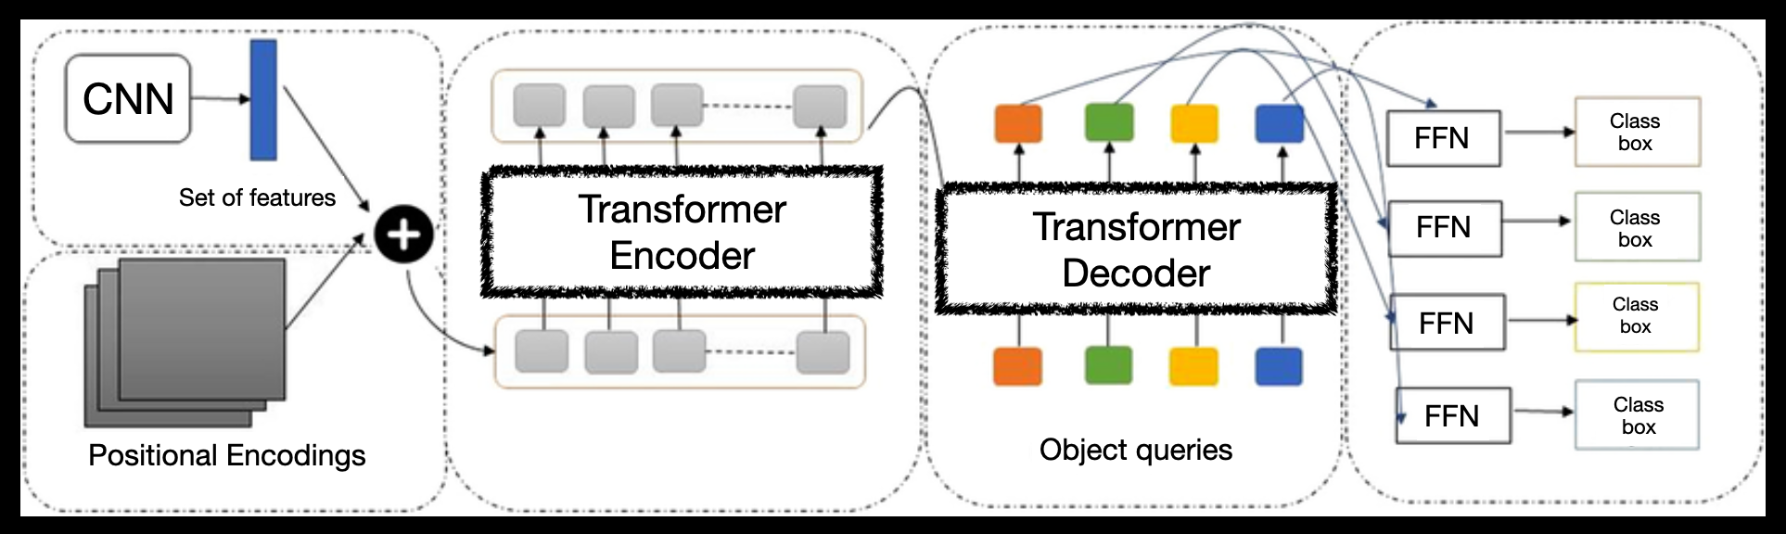
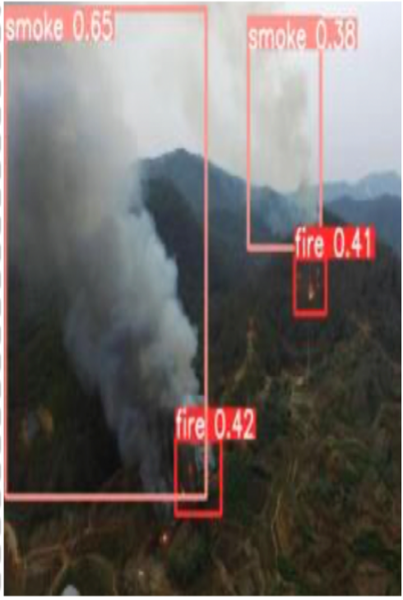
Internal Model Architecture:
Backbone
Encoder
Decoder
Prediction heads
Output
Extracts features from the input image using a pre-trained convolutional neural network.
Processes backbone features with transformer encoder layers to capture global context and spatial relationships.
Generates representations for object detections using transformer decoder layers.
Embeds spatial information into the feature maps to facilitate positional understanding.
Prediction of class probabilities and estimation of bounding box coordinates for each class detection.

Slide 8
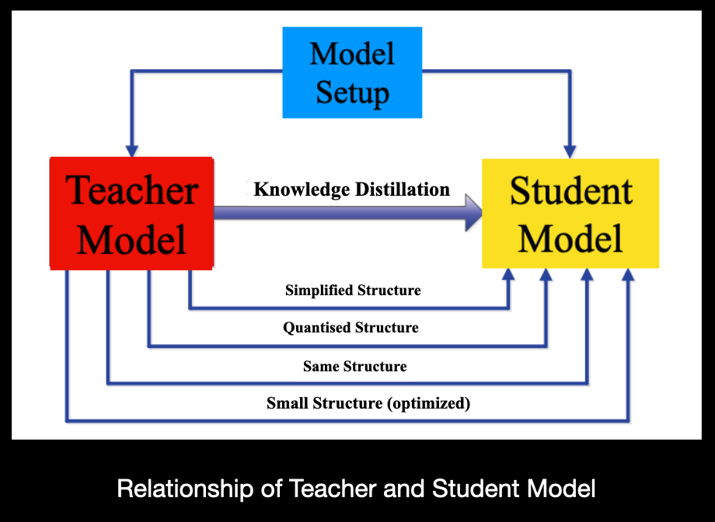
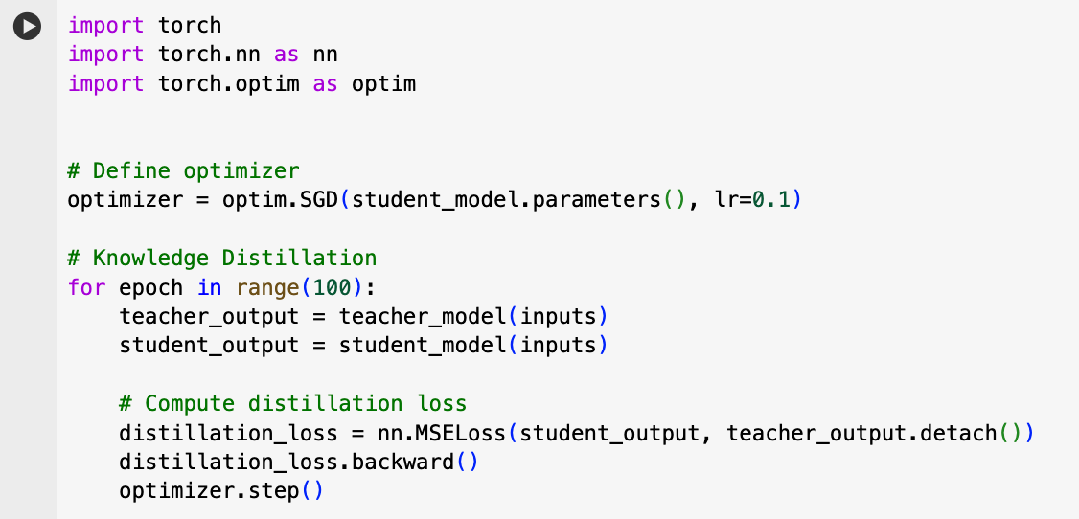
Creation of the Lightweight Model
Knowledge Distillation
Condense the model for efficient deployment on resource-constrained devices.
Preserved critical features.
Significant size reduction without compromising Performance.
Accelerated detection tasks.

Slide 9
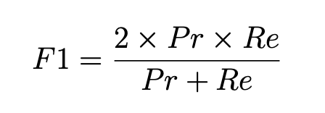
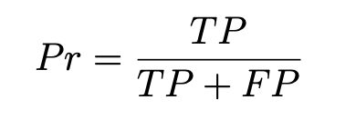
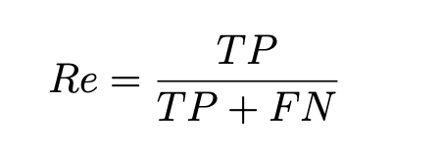
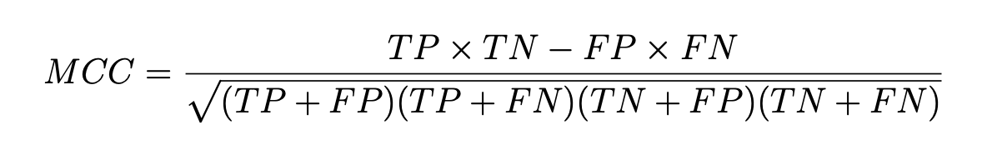
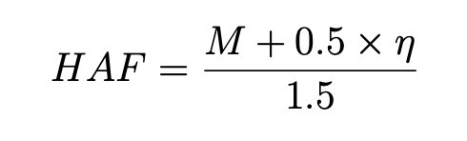
Comparison Metrics
F1 Score
Matthews Correlation Coefficient
Hafiane Quality Index

Slide 10
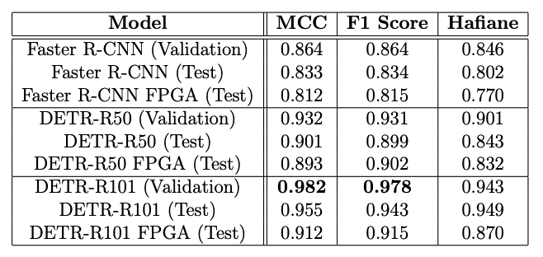
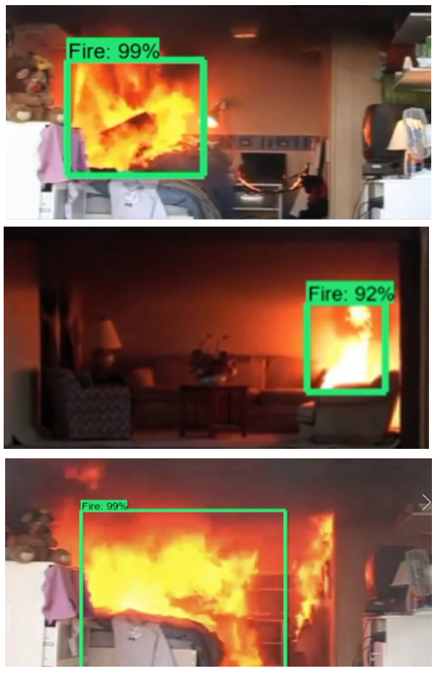
Experiments, Results and Analysis
Quantitative Comparison of Our Model with Existing Technology Across Various Metrics
Fire detection accuracy improved by 13.7%.
All FPGA devices utilize the condensed student model.
The FPGA device demonstrates remarkable detection accuracy, particularly suited for fire detection tasks.
Qualitative Results of our ResNet-101-based DETR Model

Slide 11
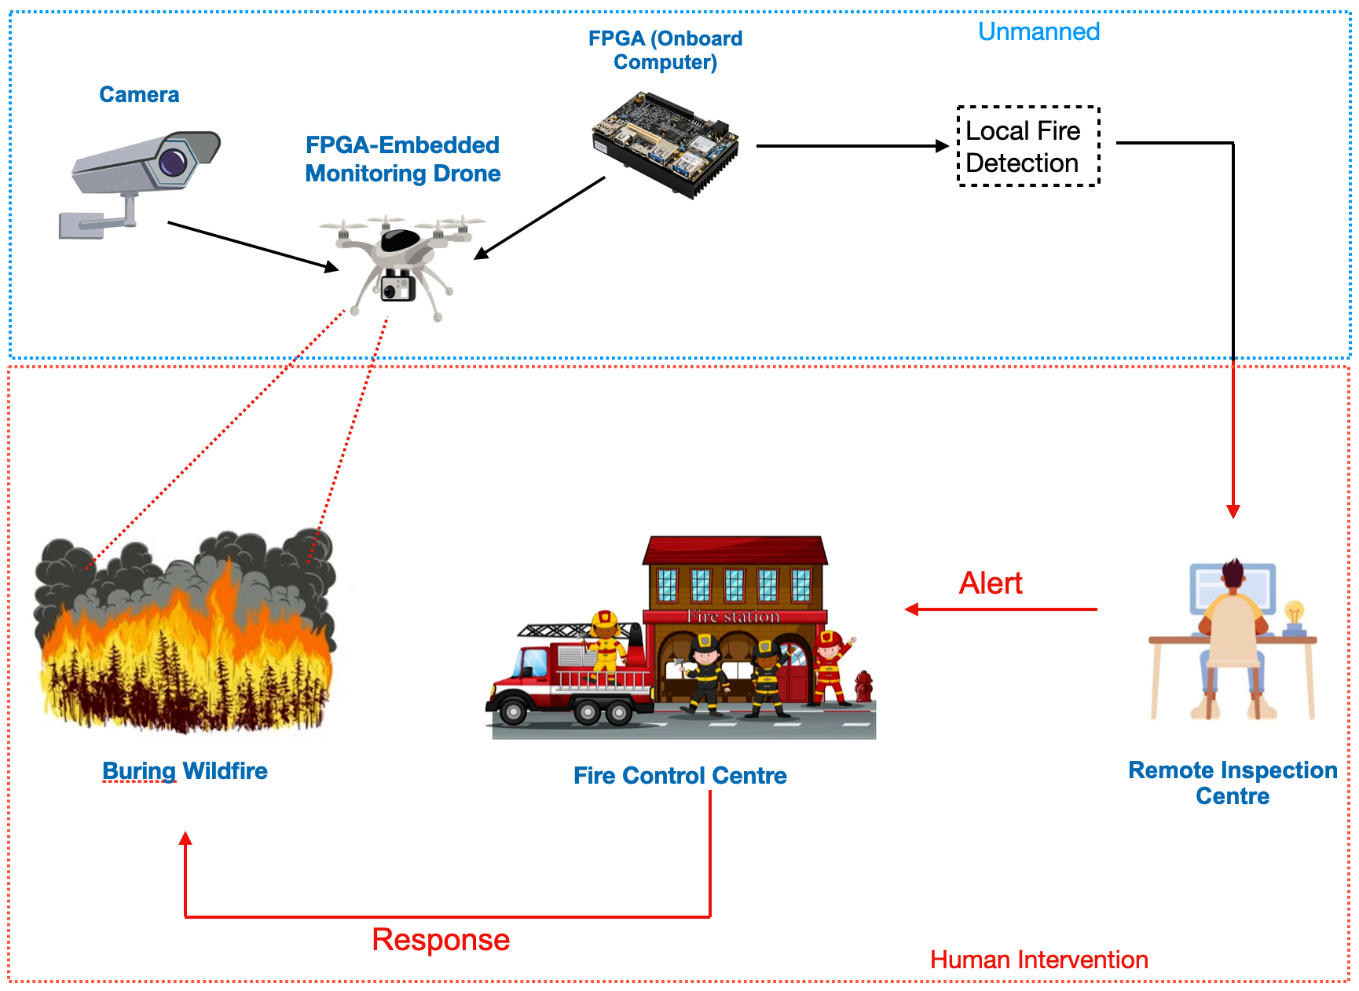
Real-Life Implementation of FPGA-Embedded Monitoring Drone

Slide 12
Conclusion
Implemented and evaluated a Camera-Embedded FPGA Accelerator for Real-time Wildfire Detection System.
Achieved outstanding performance with a F1 score of 98.33% and a False Positive Rate of 1.78%.
Attained a frame rate of 33.63 FPS for the detection task, enabling real-time monitoring.
The FPGA device achieved an average latency of 4-5 milliseconds when communicating with our local computer, ensuring swift data transfer.

Slide 13
Future Work
The CNN Backbone requires fine-tuning with the Wildfire Dataset, previously trained solely on generic objects, to enhance its adaptability and precision.
Investigate the feasibility of deploying unmanned aerial vehicles (UAVs).
Explore predictive modeling techniques for wildfire spread prediction, leveraging historical data, environmental factors, and human activity patterns.
To apply reinforcement learning algorithms to optimize wildfire detection and management.

Slide 14
Thank You!

